Slide 1
Projekt Praktikum Python
Gruppe 3:
Quoc-Nam Dessoulles
Louis-Adrien Dufrene
Claire Loffler
Hugo Robellaz
Hang Yuan

Slide 2


INTRODUCTION
From the raw data of BeagleBone to their graph display:
Transmission
BBB.py
client.py
server.py
application.py
CLIENT
SERVER

Slide 3
BeagleBoard Skript

Slide 4

IN THE BEAGLEBONE
The main objectives:
1) Get the data returned by the sensors (T, P, Humidity, Luminosity)
2) Send them to the Server Side
1) How to retrieve the raw data from the BB?
Go through the good files in the BB and return the values periodically
YES
We save it in a dictionary, where
Key = Type of data
Value = (date, value)
addData(data)
Did the data change?
NO
Ex: read_lux() or read_pressure()
RESULT:
The attribute v.data is updated

Slide 5
IN THE BEAGLEBONE
2) How to send the retrieved data to the Server side?
We periodically check if the v.data is
empty?
Call the function sendData( ) of the Client
NO
Clear v.data
YES
No new data to send
Note: The frequency of the functions getdata() and sendData() calls can be chosen by the user who launches the BB main( )

Slide 6
Client-Server Teil

Slide 7
CLIENT SIDE
Twisted library manages client/server communication
2 classes: MyClientFactory and Client
How does the Client send the received data to the Server?
New Dictionary: dict
Ex: {‘TEMPERATURE’: [(d1,v1)], ‘PRESSURE’: [(d1,v’1),(d3,v3)]…}
String
Ex:TEMPERATURE|(d1,v1)|(d2,v2)/PRESSURE|(d1,v’1)|(d3,v3)/HUMIDITY…
Convert the incoming dictionary into a string format
sendData(dict)
CLIENT

Slide 8
SERVER SIDE
2 classes: ServerFactory and Server
2 main goals:
1) From the received string, construct again the initial dictionary
2) Save it into the .csv file
lineReceived
String
Ex: TEMPERATURE|(d1,v1)|
(d2,v2)/PRESSURE|(d1,v’1)|
(d3,v3)/HUMIDITY…
Convert back into the dict
format
saveDataCSV
addData
SERVER

Slide 9
Verarbeitung

Slide 10
SAVING OF DATA
New data: dictionary
{‘TEMPERATURE’: [(d3,t3)],
‘PRESSURE’: [(d3,p3)],
‘HUMIDITY’: [(d3,h3)],
‘LUMINOSITY’: [(d3,l3)] }
The data is sorted: d1<d2<d3<d4<d5
Caller
Fusion:
addData( )
The conversion extrapolates missing plots and deletes redundant data.
Saving:
saveData( )
pickle.dump( )
Main data: dictionary
{‘TEMPERATURE’: [(d3,t3)],
‘PRESSURE’: [(d1,p1),(d3,p3)],
‘HUMIDITY’: [(d2,h2),(d3,h3),(d4,h4)],
‘LUMINOSITY’: [(d3,l3),(d5,l5)] }
Conversion:
saveDataCSV( )
Loading data:
loadData( )
pickle.load( )
Saved data: pickle file
(dp0 S'PRESSURE’ p1 (lp2 (I1373201989
I30 tp3 a(I1373209921 I35 tp4
a(I1373222477 I18 tp5 a(I1373248440 I9
tp6 a(I1373248663 I33 tp7 a(I1373253515
I36 ...
Converted data: CSV file
2013-07-07 15:09:42,25.7,45,356,1025
2013-07-07 15:54:21,26.2,47,342,1024
2013-07-07 15:59:17,26.3,48,334,1024
2013-07-07 19:20:44,25.9,52,302,1017
2013-07-07 19:57:18,24.5,53,285,1015

Slide 11

User Interface

Slide 12

Pyramid
Template designed in HTML (Chameleon)
Serve Static Files (CSS, JS…)
Serve dynamically plot image files (FileResponse)
Easy use of GET & POST Requests

Slide 13
Structure
Application.py
:Inherit
Layouts
ProjectorViews
globals.py
Graph(data)
Graph
getData( )
Data( )
Data
cacheData( )
dataSaved.csv

Slide 14
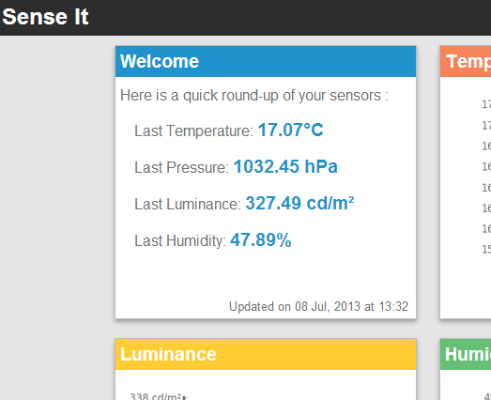
Demo

Slide 15

CONCLUSION
Two main problems we faced during the course of the project:
1) Internal communication
Boundary of everyone’s work
2) Initialization of Beagle Bone
Installation of modules (like Twisted)

Slide 16


Thank you for your attention!

